Slide 1

CLOUD ASSESSMENT
Prepared For: Google Lab Customer 20041
February 01, 2022
Delivered By: StratoZone LLC.
www.stratozone.com
NOTICE OF CONFIDENTIALITY
This document contains proprietary and confidential information. It is being furnished to the recipient shown above in confidence with the understanding that it will not, without prior permission of StratoZone LLC, be duplicated, used, or disclosed in whole or in part for any reason other than for evaluation by the recipient.
CONFIDENTIAL

Slide 2
Table of Contents
Introduction
Our Assessment and Planning Approach
What We Did for Your Assessment
What We Looked At
What We Found at a High Level
Location/Group Based Findings
Cloud Readiness
Infrastructure-as-a-Services (IaaS) Fit Score
Platform-as-a-Services (PaaS) Fit Candidates
Financial Comparison
Cost Center
Next Steps
CONFIDENTIAL

Slide 3
Introduction
Shaping the what, where, when, and how of a transition to the cloud is essential to optimizing cost and reducing risk. The StratoZone® Cloud Assessment and Planning Service (CAPS) delivers a powerful assessment and cloud-decision-framework that answers these questions with quantitative and qualitative analysis.
Our assessment, driven by the industry-leading StratoZone® SaaS platform, lays the groundwork to help you analyze your current infrastructure efficiency, plan for public or hybrid cloud, create financial justification, get true cost of ownership, and reduce migration risk. This solution rapidly provides critical insights for customers planning to integrate public or hybrid cloud into their computing infrastructure while delivering actionable results.
Our capabilities extend beyond the assessment to advanced planning and execution including application mapping, cloud architecture, migration planning, and migration execution, thereby providing a singular, end-to-end service for enterprise customers.
CONFIDENTIAL

Slide 4
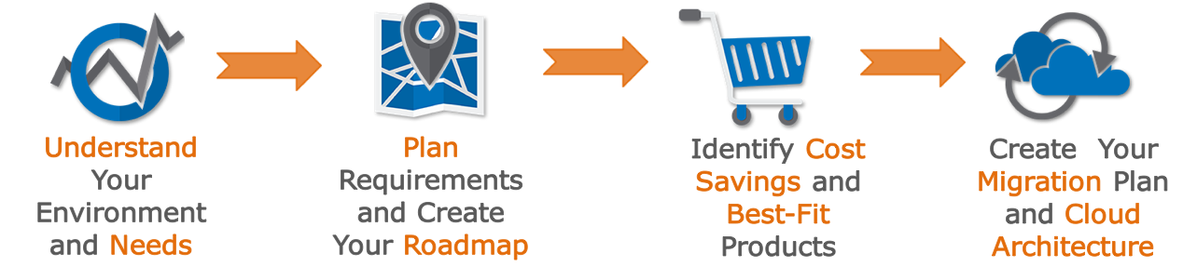
Our Assessment and Planning Approach
Our proven assessment and planning approach shown below was employed for your engagement and integrated the data collection, analytics, and brokerage capabilities of the StratoZone® platform.
A critical component of any cloud assessment or planning service is to collect and rely on accurate and timely data. As the first step of your assessment, the StratoProbe® data collection application is deployed to retrieve and analyze data from your environments.
Once discovery is completed, the StratoZone® platform is used to analyze data relating to your IT assets that are deemed to be in scope. This analysis is a combination of proprietary technical methodologies combined with robust industry benchmark data, and real-time pricing from the cloud-providers you selected for your assessment.
The findings, analysis, and recommendations are made available to you within your StratoZone® portal and summarized in this report.
CONFIDENTIAL

Slide 5
What We Did for Your Assessment
Your engagement included a basic assessment. The basic assessment is a starting point for any customer embarking on the journey to public or hybrid cloud. One or more data collectors were deployed in your environment and your data was automatically aggregated, analyzed, and staged for additional planning functions. The phases and tasks of the basic assessment are shown below:
1 | Phase 1: Discovery, Inventory Analysis, and Cloud Readiness The objective of this phase is to collect data from the target assets and complete inventory analysis including basic cloud readiness. The StratoProbe® discovery engine gathered asset, application and network information and processed the following analytics: • Inventory Analysis • Asset performance analysis • Network dependency mapping • Cloud-readiness scoring • Application inventory analysis
2 | Phase 2: Basic Cloud Fit and Financial Analysis The objective of this phase is to further analyze your data to provide insights into cloud readiness, potential savings from cloud, consumption strategies including IaaS and PaaS alternatives, and to review your projected spend in the selected cloud providers. The expected output from this phase includes: • Best-fit vendor-product match (IaaS) • PaaS-fit analysis • IaaS-fit analysis • Cloud-spend estimates (by vendor) • TCO and ROI against benchmark baselines
CONFIDENTIAL

Slide 6
What We Looked At
This assessment is intended to analyze specific areas within your computing environment as designated by you or your personnel. It is important to note that this engagement may not have been a comprehensive assessment of your entire environment. All locations that we analyzed along with the count of assets in each location are shown below.
 | Location | Type | Contact | Start Date | End Date | Total Assets
#{TableId:TotalAssets} | Location | Type | Contact | 01-Jan-2000 | 01-Jan-2020 | 0
CONFIDENTIAL

Slide 7
 | Location | Type | Contact | Start Date | End Date | Total Assets
1 | San Francisco | Automatic Asset Discovery | 27-Jul-2016 | 03-Aug-2016 | 7
2 | New York | Automatic Asset Discovery | 27-Jul-2016 | 03-Aug-2016 | 3
3 | Atlanta | Automatic Asset Discovery | 26-Aug-2016 | 02-Sep-2016 | 1
4 | Chicago | Automatic Asset Discovery | 09-Sep-2016 | 17-Sep-2016 | 11
5 | Boston | Automatic Asset Discovery | 09-Sep-2016 | 16-Sep-2016 | 3
6 | Lab Datacenter | Automatic Asset Discovery | 01-Feb-2022 | 04-Mar-2022 | 3
7 | Lab Datacenter Manual | Manual Asset Entry | 19-Nov-2021 | 20-Nov-2021 | 19
CONFIDENTIAL

Slide 8
What We Found At A High Level
CONFIDENTIAL

Slide 9
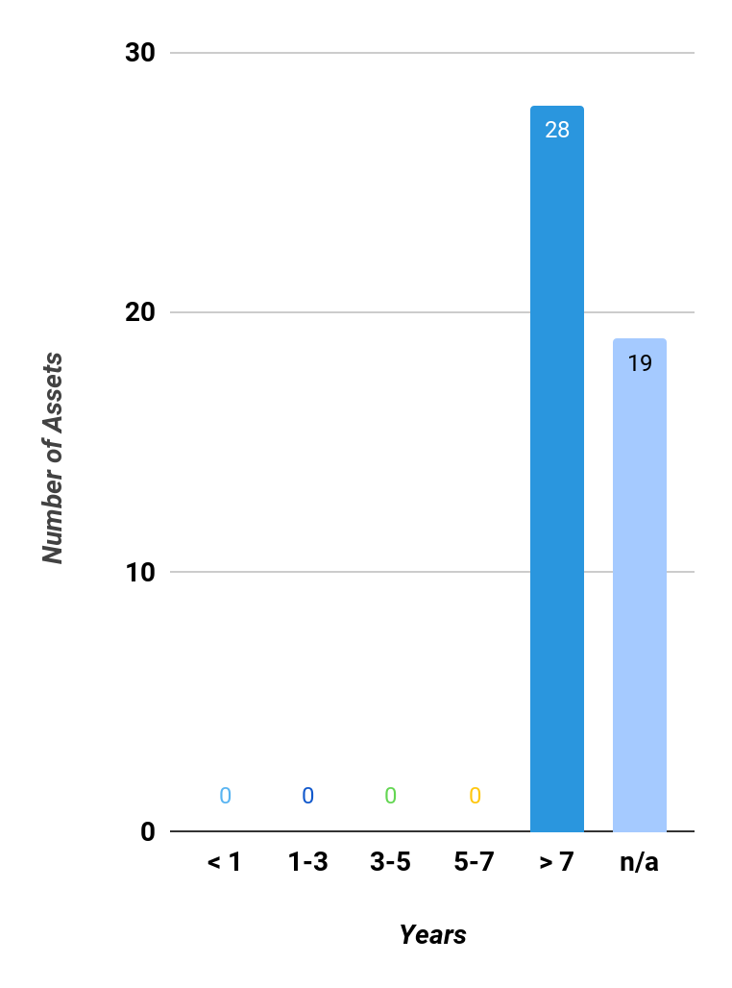
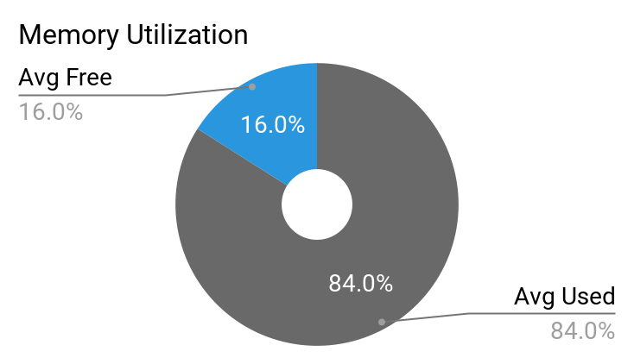
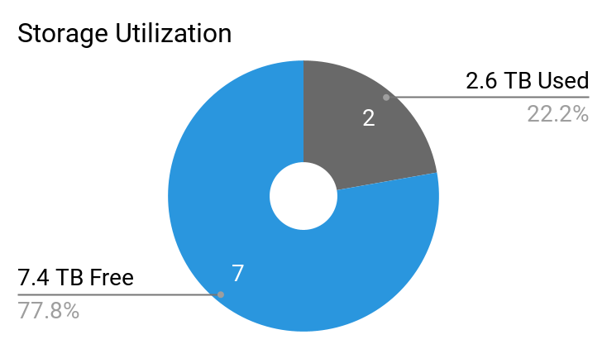
High Level Findings
This section represents the high-level findings we summarized from across your in-scope environments. You may access additional information and analytics by logging into your StratoZone® portal account.
Assets
Total | Windows | Linux
47 | 29 | 18
StratoFit Score
High | Medium | Low
47 | 0 | 0
CPU Cores
185 Cores
Installed Software
551 Apps
Total Memory
636 TBs
Total Storage
9.9 TBs
CONFIDENTIAL

Slide 10
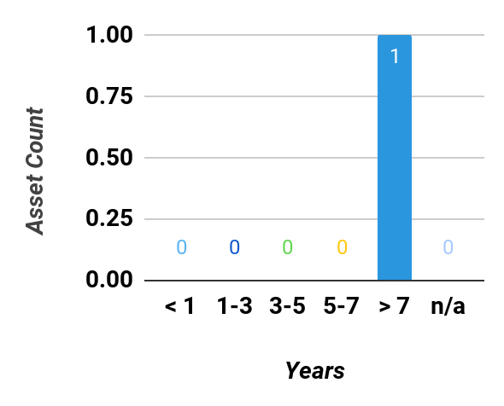
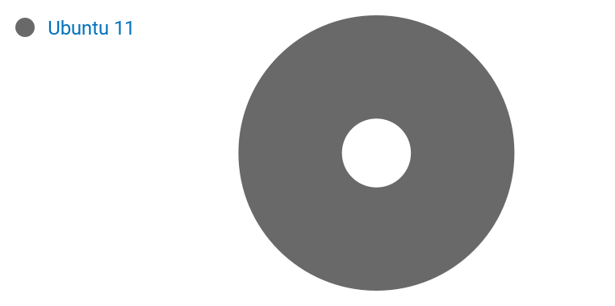
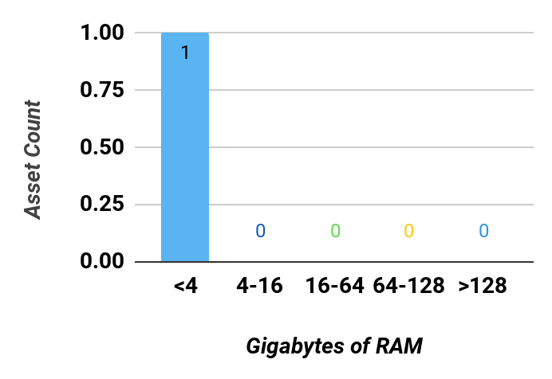
Findings for Atlanta
Age Distribution | Operating Systems | Memory Distribution
Asset Statistics
Total Assets: | 1
Total Storage: | 4.8 GB
Average Asset Age: | 10.3
Average Memory: | 4 GB
Asset Performance
Total Used Storage: | 35.8 MB
Average Used Memory: | 75%
Average Peak Memory: | 80%
Average CPU Usage: | 99%
Average Peak CPU Usage: | 100%
CONFIDENTIAL

Slide 11
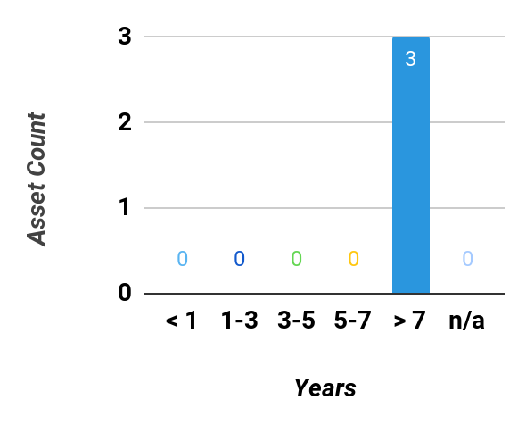
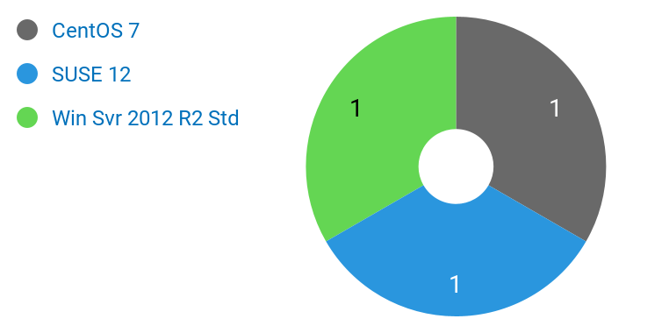
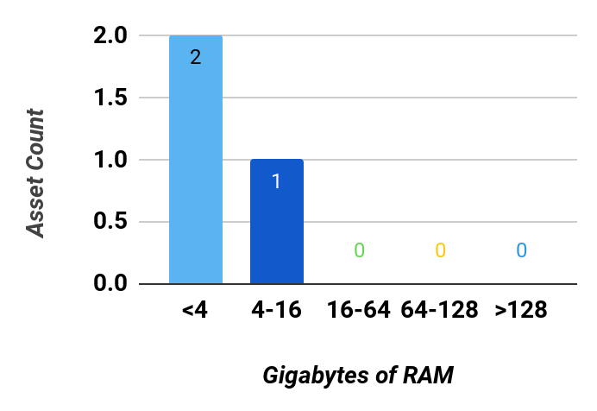
Findings for Boston
Age Distribution | Operating Systems | Memory Distribution
Asset Statistics
Total Assets: | 3
Total Storage: | 236.7 GB
Average Asset Age: | 9.9
Average Memory: | 2 GB
Asset Performance
Total Used Storage: | 75.4 GB
Average Used Memory: | 84%
Average Peak Memory: | 89%
Average CPU Usage: | 48%
Average Peak CPU Usage: | 49%
CONFIDENTIAL

Slide 12
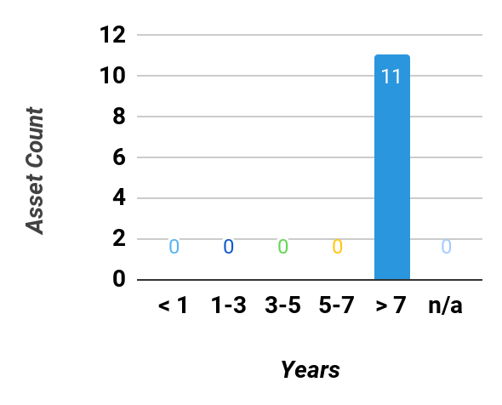
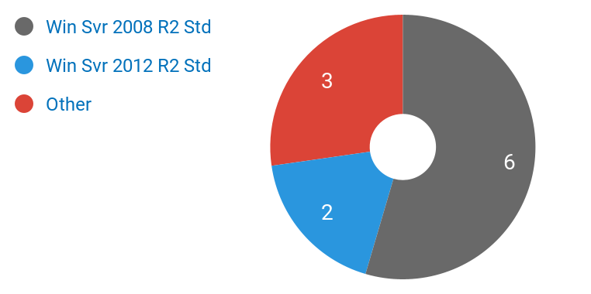
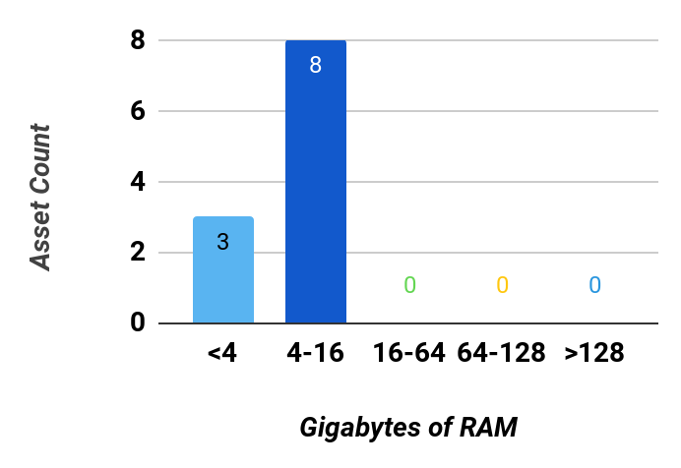
Findings for Chicago
Age Distribution | Operating Systems | Memory Distribution
Asset Statistics
Total Assets: | 11
Total Storage: | 2.4 TB
Average Asset Age: | 9.3
Average Memory: | 4 GB
Asset Performance
Total Used Storage: | 975.6 GB
Average Used Memory: | 86%
Average Peak Memory: | 90%
Average CPU Usage: | 21%
Average Peak CPU Usage: | 23%
CONFIDENTIAL

Slide 13
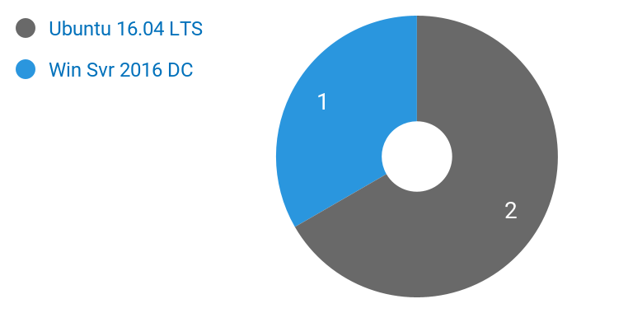
Findings for Lab Datacenter
Age Distribution | Operating Systems | Memory Distribution
Asset Statistics
Total Assets: | 3
Total Storage: | 74.8 GB
Average Asset Age: | 11.1
Average Memory: | 4 GB
Asset Performance
Total Used Storage: | 26.4 GB
Average Used Memory: | 27%
Average Peak Memory: | 27%
Average CPU Usage: | 27%
Average Peak CPU Usage: | 27%
CONFIDENTIAL

Slide 14
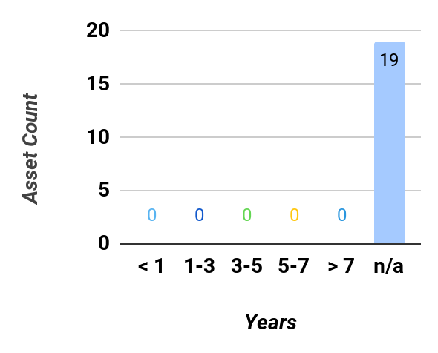
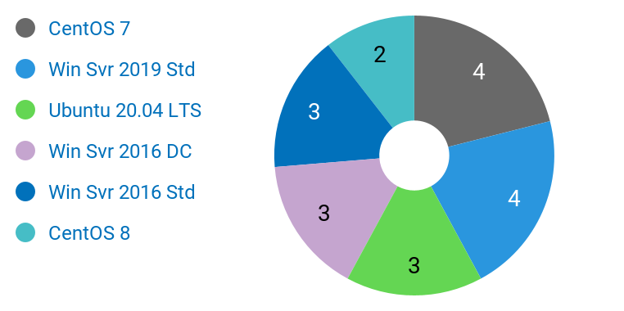
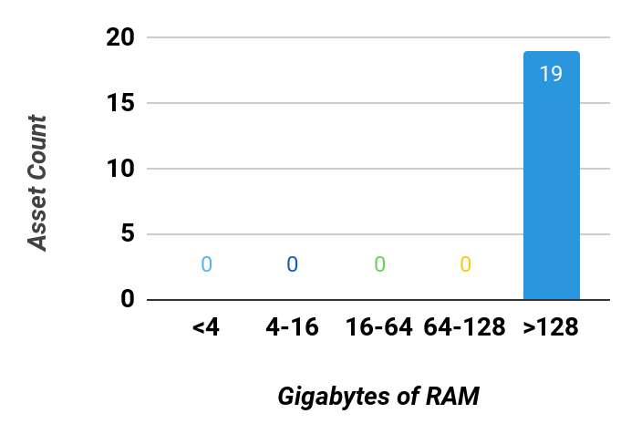
Findings for Lab Datacenter Manual
Age Distribution | Operating Systems | Memory Distribution
Asset Statistics
Total Assets: | 19
Total Storage: | 5.0 TB
Average Asset Age:
Average Memory: | 33 TB
Asset Performance
Total Used Storage: | 950 GB
Average Used Memory: | %
Average Peak Memory: | %
Average CPU Usage: | %
Average Peak CPU Usage: | %
CONFIDENTIAL

Slide 15
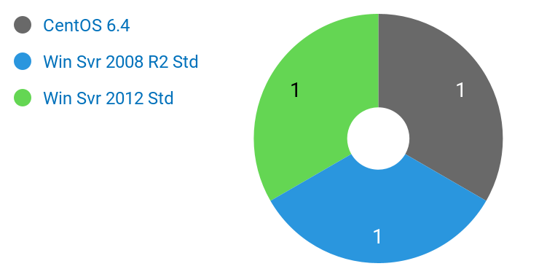
Findings for New York
Age Distribution | Operating Systems | Memory Distribution
Asset Statistics
Total Assets: | 3
Total Storage: | 100.9 GB
Average Asset Age: | 9.7
Average Memory: | 3 GB
Asset Performance
Total Used Storage: | 39.9 GB
Average Used Memory: | 84%
Average Peak Memory: | 88%
Average CPU Usage: | 28%
Average Peak CPU Usage: | 31%
CONFIDENTIAL

Slide 16
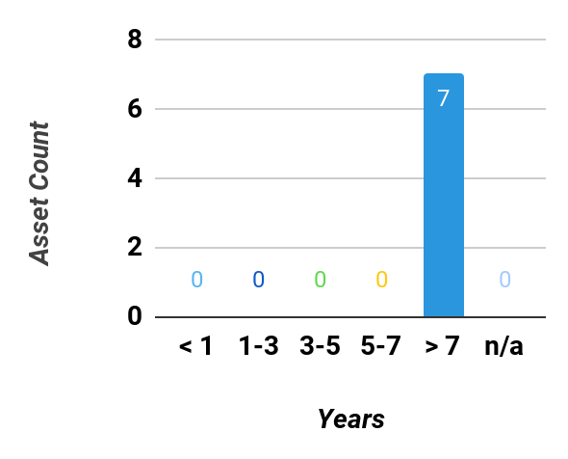
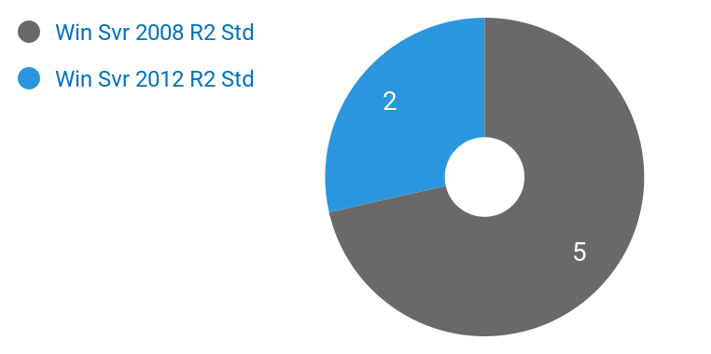
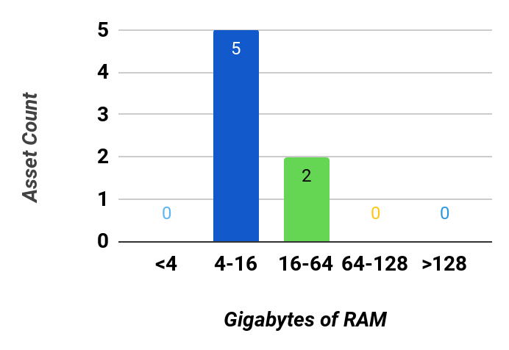
Findings for San Francisco
Age Distribution | Operating Systems | Memory Distribution
Asset Statistics
Total Assets: | 7
Total Storage: | 2.1 TB
Average Asset Age: | 9.2
Average Memory: | 13 GB
Asset Performance
Total Used Storage: | 544.7 GB
Average Used Memory: | 88%
Average Peak Memory: | 93%
Average CPU Usage: | 6%
Average Peak CPU Usage: | 7%
CONFIDENTIAL

Slide 17
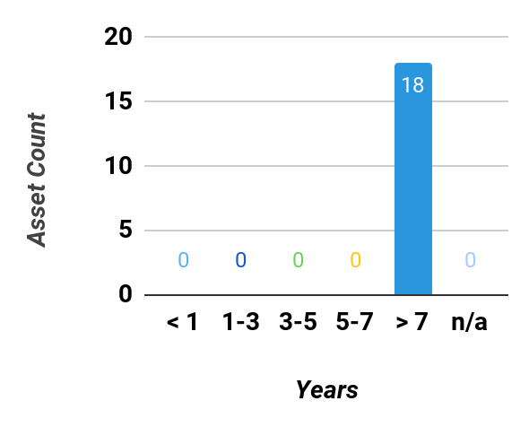
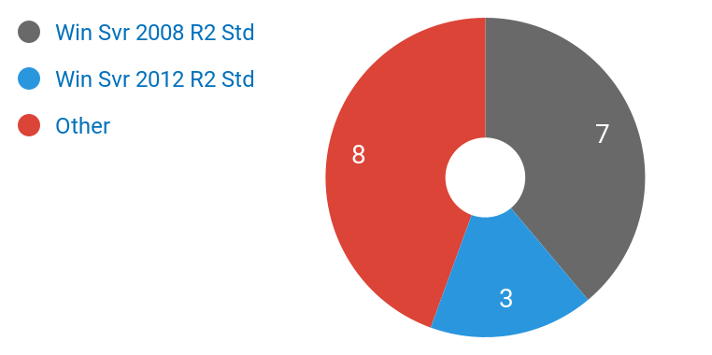
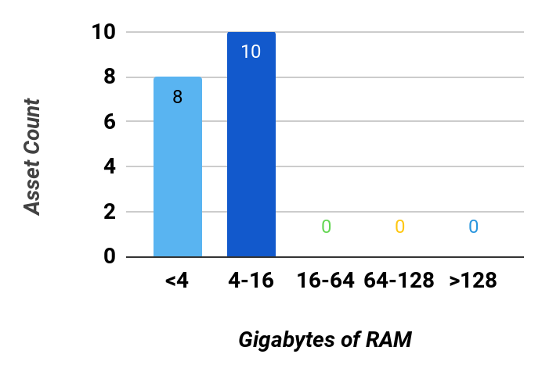
Findings for Dev / Test Servers
Age Distribution | Operating Systems | Memory Distribution
Asset Statistics
Total Assets: | 18
Total Storage: | 2.7 TB
Average Asset Age: | 9.4
Average Memory: | 4 GB
Asset Performance
Total Used Storage: | 1.1 TB
Average Used Memory: | 85%
Average Peak Memory: | 89%
Average CPU Usage: | 31%
Average Peak CPU Usage: | 33%
CONFIDENTIAL

Slide 18
Findings for Production Servers
Age Distribution | Operating Systems | Memory Distribution
Asset Statistics
Total Assets: | 7
Total Storage: | 2.1 TB
Average Asset Age: | 9.2
Average Memory: | 13 GB
Asset Performance
Total Used Storage: | 544.7 GB
Average Used Memory: | 88%
Average Peak Memory: | 93%
Average CPU Usage: | 6%
Average Peak CPU Usage: | 7%
CONFIDENTIAL

Slide 19
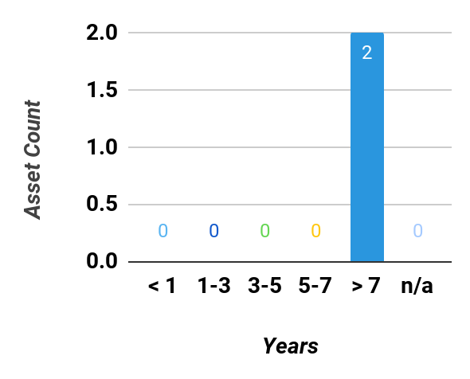
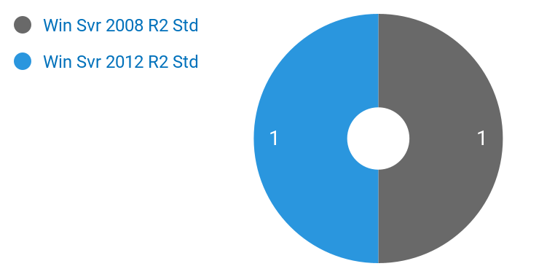
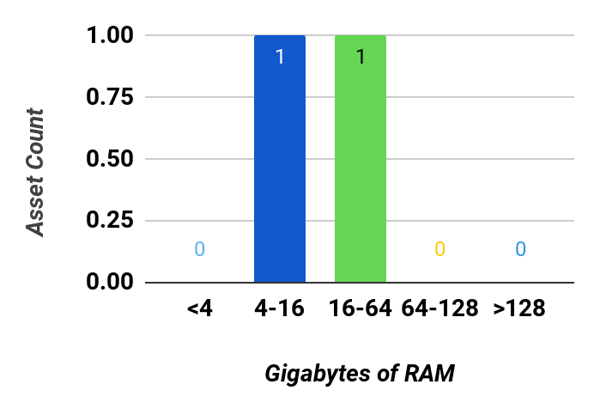
Findings for ERP - Development
Age Distribution | Operating Systems | Memory Distribution
Asset Statistics
Total Assets: | 2
Total Storage: | 839.5 GB
Average Asset Age: | 8.5
Average Memory: | 26 GB
Asset Performance
Total Used Storage: | 265.9 GB
Average Used Memory: | 90%
Average Peak Memory: | 93%
Average CPU Usage: | 10%
Average Peak CPU Usage: | 11%
CONFIDENTIAL

Slide 20

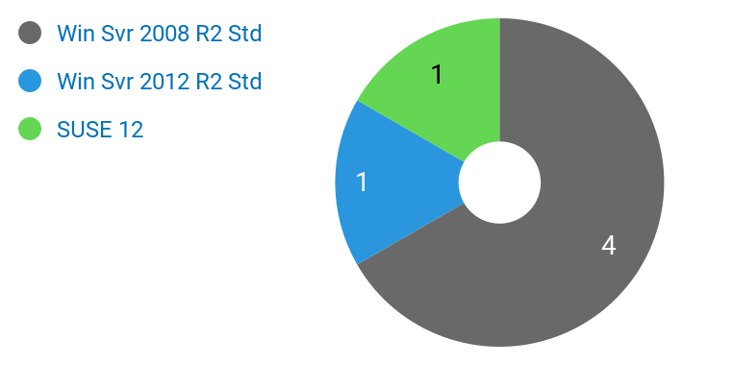
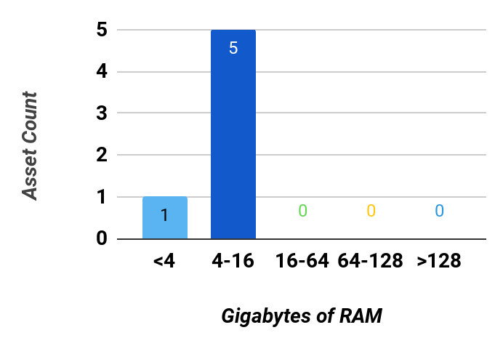
Findings for ERP - Production
Age Distribution | Operating Systems | Memory Distribution
Asset Statistics
Total Assets: | 6
Total Storage: | 741.4 GB
Average Asset Age: | 9.3
Average Memory: | 4 GB
Asset Performance
Total Used Storage: | 263.7 GB
Average Used Memory: | 87%
Average Peak Memory: | 92%
Average CPU Usage: | 24%
Average Peak CPU Usage: | 26%
CONFIDENTIAL

Slide 21

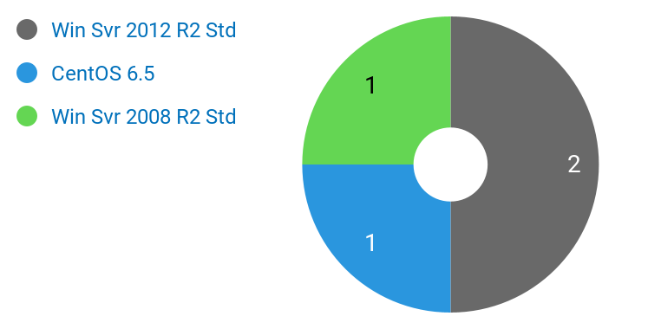
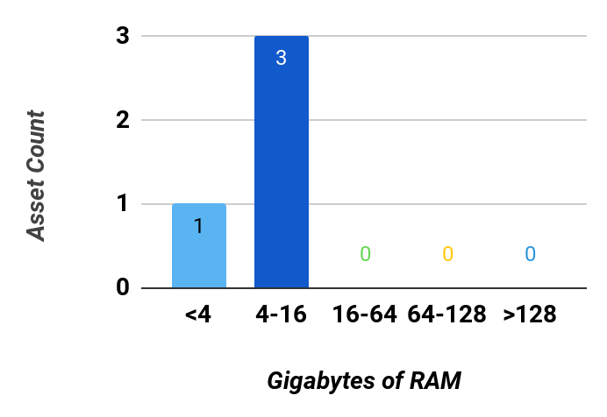
Findings for OrderON - Production
Age Distribution | Operating Systems | Memory Distribution
Asset Statistics
Total Assets: | 4
Total Storage: | 176.5 GB
Average Asset Age: | 9.7
Average Memory: | 4 GB
Asset Performance
Total Used Storage: | 94.2 GB
Average Used Memory: | 85%
Average Peak Memory: | 89%
Average CPU Usage: | 10%
Average Peak CPU Usage: | 12%
CONFIDENTIAL

Slide 22
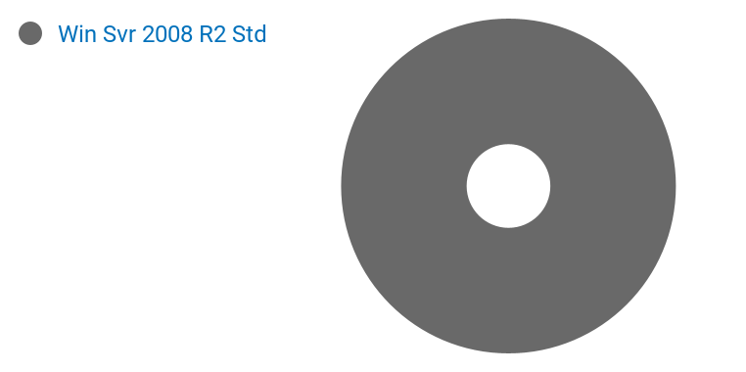
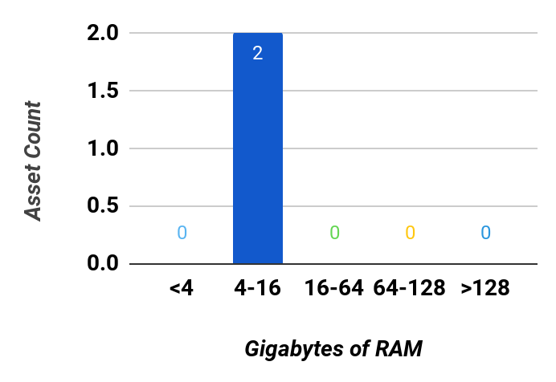
Findings for OrderON - Test
Age Distribution | Operating Systems | Memory Distribution
Asset Statistics
Total Assets: | 2
Total Storage: | 229.8 GB
Average Asset Age: | 9.7
Average Memory: | 4 GB
Asset Performance
Total Used Storage: | 148.0 GB
Average Used Memory: | 94%
Average Peak Memory: | 95%
Average CPU Usage: | 12%
Average Peak CPU Usage: | 14%
CONFIDENTIAL

Slide 23
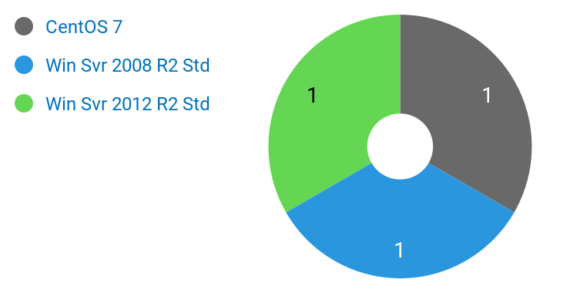
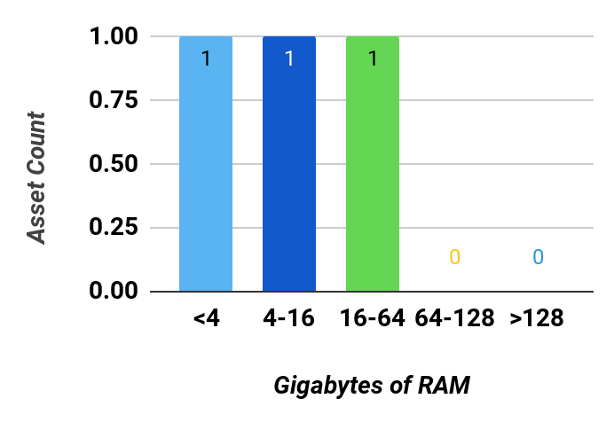
Findings for Boston
Age Distribution | Operating Systems | Memory Distribution
Asset Statistics
Total Assets: | 3
Total Storage: | 879.5 GB
Average Asset Age: | 9.2
Average Memory: | 18 GB
Asset Performance
Total Used Storage: | 249.7 GB
Average Used Memory: | 86%
Average Peak Memory: | 90%
Average CPU Usage: | 6%
Average Peak CPU Usage: | 7%
CONFIDENTIAL

Slide 24

Findings for Chicago
Age Distribution | Operating Systems | Memory Distribution
Asset Statistics
Total Assets: | 1
Total Storage: | 149.9 GB
Average Asset Age: | 9.7
Average Memory: | 4 GB
Asset Performance
Total Used Storage: | 91.0 GB
Average Used Memory: | 94%
Average Peak Memory: | 96%
Average CPU Usage: | 16%
Average Peak CPU Usage: | 18%
CONFIDENTIAL

Slide 25
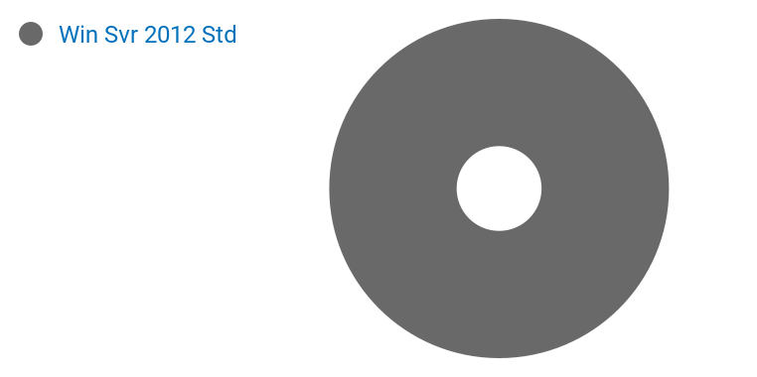
Findings for New York
Age Distribution | Operating Systems | Memory Distribution
Asset Statistics
Total Assets: | 1
Total Storage: | 39.7 GB
Average Asset Age: | 9.7
Average Memory: | 4 GB
Asset Performance
Total Used Storage: | 16.1 GB
Average Used Memory: | 83%
Average Peak Memory: | 89%
Average CPU Usage: | 16%
Average Peak CPU Usage: | 18%
CONFIDENTIAL

Slide 26
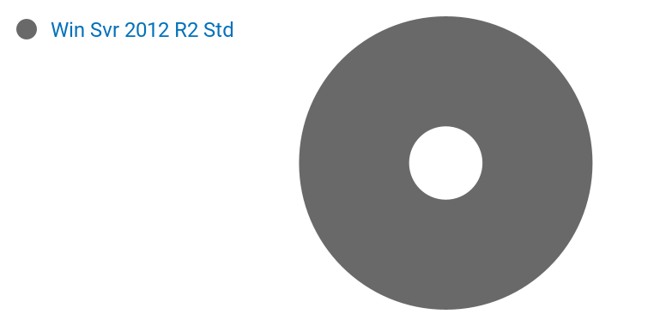
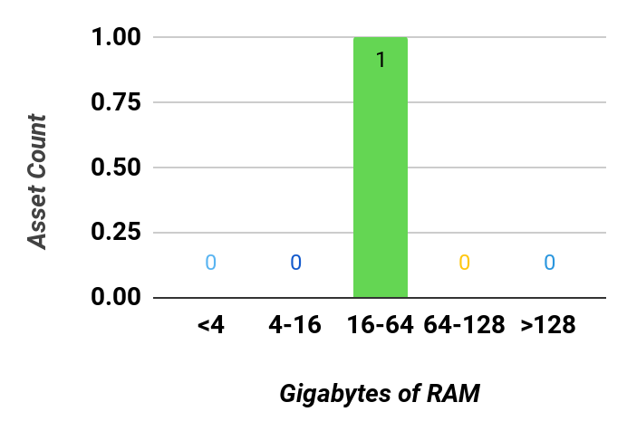
Findings for San Francisco
Age Distribution | Operating Systems | Memory Distribution
Asset Statistics
Total Assets: | 1
Total Storage: | 739.7 GB
Average Asset Age: | 7.4
Average Memory: | 48 GB
Asset Performance
Total Used Storage: | 207.2 GB
Average Used Memory: | 98%
Average Peak Memory: | 99%
Average CPU Usage: | 7%
Average Peak CPU Usage: | 8%
CONFIDENTIAL

Slide 27
Cloud Readiness
CONFIDENTIAL

Slide 28
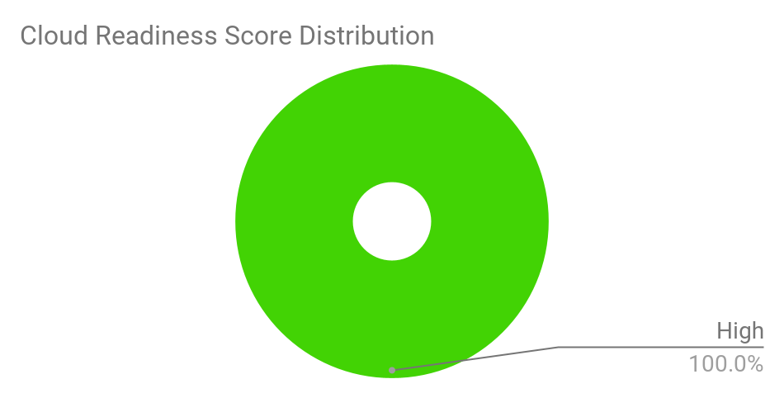
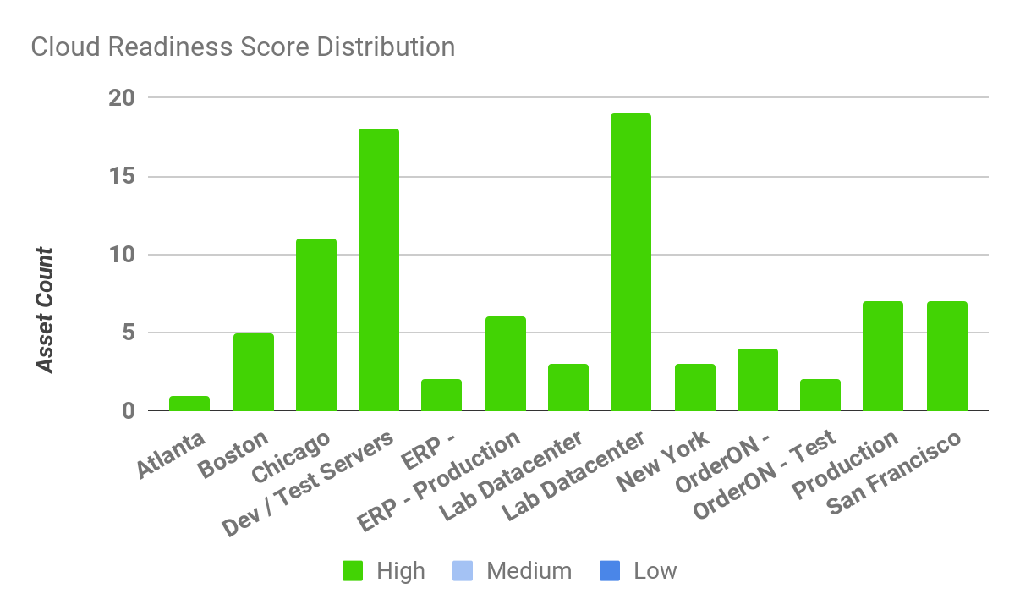
Cloud Readiness Findings
We conducted a cloud readiness analysis on each of the assets within your assessment scope. The resulting cloud readiness score is intended to capture the asset's fit in public cloud, based on specific infrastructure characteristics. These characteristics include capacity, performance, age, operating systems, and other machine-based attributes.
Overall, this score describes the level of remediation your assets might require for a successful migration to public cloud (under a re-host migration). This score may impact the total cost of migrating certain assets to public cloud. The cloud readiness score for all your selected build groups is shown below.
CONFIDENTIAL

Slide 29
Cloud Readiness Preferences
The cloud readiness score is impacted by your response to questions in the StratoZone® portal. The table below shows the parameters that are taken into consideration for the basic cloud readiness scoring along with your indicated preference for each parameter.
The StratoSlate® planning engine can be used to further analyze the impact of effort and cost, as well as a services engagement with StratoZone® or your delivery partner.
Cloud Readiness Characteristic | Your Indicated Importance
Your preference regarding high-performance assets | Maybe
Your ability to exit a selected public cloud provider | Somewhat
Your preference regarding older assets | Somewhat
Your preference to migrate certain higher-risk roles (ex: DB Server) | Maybe
Your desire to move assets with high network dependency | Yes
Your preference regarding remediating unsupported OS’s | Yes
CONFIDENTIAL

Slide 30
Infrastructure-as-a-Service (IaaS) Fit Score
Your assets were analyzed to determine the remediation level required for migration to public cloud infrastructure-as-a-service (IaaS) products. Each asset was broadly categorized into a high, medium, or low fit group.
Assets with medium scores may require remediation prior to public cloud migration, and assets with low scores may not be feasible cloud-fit candidates. Using the StratoSlate® planning engine, we can conduct additional analysis to determine the remediation type, associated cost, and effort level required for public cloud IaaS. Assets falling in the high, medium, and low remediation categories are shown below.
CloudFit - IaaS
CONFIDENTIAL

Slide 31
Platform-as-a-Service (PaaS) Fit Candidates
This assessment identified assets that qualify for migration to platform-as-a-service (PaaS) in public cloud. These PaaS-qualifying assets are shown below. The PaaS categories are shown in your StratoZone® portal. Further analysis is necessary to determine the associated cost, risk, and effort level required to migrate these assets to a public cloud platform-as-a-service.
CloudFit - PaaS
CONFIDENTIAL

Slide 32
Financial Comparison
We conducted a basic financial comparison for each of your assets within the designated groups. This comparison is conducted at the infrastructure-level, using the process shown below:
Step 1 | Performance-based right-sizing
 | We right-sized each asset’s capacity for a public-cloud metered model. Asset capacity includes CPU, memory, bandwidth, up-time, OS licensing, and storage performance.
Step 2 | Selection of best-fit public cloud product
 | We selected the best-fit cloud products from each of your designated vendors, based on capacity, performance, and price.
Step 3 | Compare to benchmark environment
 | We compared your assets to the best-match benchmark t-shirt sizes, and selected the closest match from your cloud providers.
The financial comparison results are shown on the following page(s). At this stage, the financial comparison does not account for all cost-of-ownership components. Excluded items typically relate to third-party products (such as DR or monitoring) that are sometimes required to operate assets in public cloud. Additionally, this analysis does not take into consideration application modernization, platform-as-a-service migrations, or other cloud–native enhancements that may be available to your asset inventory. Using the StratoSlate® planning engine, or by engaging your delivery partner, we can conduct additional analysis to determine total cost of ownership and return on investment, on a multi-year basis.
CONFIDENTIAL

Slide 33
Locations: Atlanta
1 Asset
Cost Component (Monthly) | Private Data Center | GCE (On-demand) | GCE (1 Year Commit) | GCE (3 Year Commit)
Hosting Location: | North America | Iowa (us-central1) | Iowa (us-central1) | Iowa (us-central1)
Compute: | $154.83 | $41.82 | $25.10 | $17.93
Operating System: | $0.00 | $0.00 | $0.00 | $0.00
Storage: | $1.27 | $0.40 | $0.40 | $0.40
Egress: | $0.00 | $0.85 | $0.85 | $0.85
Other Costs: | $0.00 | $0.00 | $0.00 | $0.00
Total Monthly Cost: | $156.10 | $43.07 | $26.35 | $19.18
Monthly Savings: |  | $113.04 72.4% | $129.75 83.1% | $136.92 87.7%
#{TableId:FinancialComparisonTable-Footer}
CONFIDENTIAL

Slide 34
Locations: Atlanta
Financial Assumptions, based on Moderate-level optimization
Sizing and Requirements
Machines were sized based on the following performance metrics based on average performance data:
CPU utilization target of 70% (cloud assets would utilize up to 70% of CPU based on detected utilization)
RAM utilization target of 85% (cloud assets would utilize up to 85% of RAM based on detected utilization)
Target drive type (e.g. SSD vs. Standard) determined based on a detected IOPS threshold of 500 IOPS
Storage amount based on used storage with a 25% uplift
Estimated outbound bandwidth incurring egress charges based on 10% of total outbound detected network traffic
Target cloud provider CPU performance will meet at least 100% of the detected CPU benchmark of the machine
Catalogs
Google On-Demand catalogs include Sustained Use Discounts based on runtime, where applicable
The following categories of machines were excluded for comparison:
Private Data Center | GCE (On-demand) | GCE (1 Year Commit) | GCE (3 Year Commit)
None | • E2 Preemptible • E2 Shared-core • N1 Preemptible • N1 Shared-core • N2 Preemptible • N2D Preemptible | • E2 Preemptible • E2 Shared-core • N1 Preemptible • N1 Shared-core • N2 Preemptible • N2D Preemptible | • E2 Preemptible • E2 Shared-core • N1 Preemptible • N1 Shared-core • N2 Preemptible • N2D Preemptible
Machine Uptime
All machines assumed to be running full time (730 hours, on average, per month)
Operating System Licensing Strategy
Current on-premise operating system licenses to be brought to cloud, where possible
CONFIDENTIAL

Slide 35
Locations: Boston
3 Assets
Cost Component (Monthly) | Private Data Center | GCE (On-demand) | GCE (1 Year Commit) | GCE (3 Year Commit)
Hosting Location: | North America | Iowa (us-central1) | Iowa (us-central1) | Iowa (us-central1)
Compute: | $464.50 | $95.37 | $57.25 | $40.90
Operating System: | $3.36 | $33.58 | $33.58 | $33.58
Storage: | $12.71 | $4.00 | $4.00 | $4.00
Egress: | $0.00 | $0.00 | $0.00 | $0.00
Other Costs: | $0.00 | $0.00 | $0.00 | $0.00
Total Monthly Cost: | $480.57 | $132.95 | $94.83 | $78.48
Monthly Savings: |  | $347.62 72.3% | $385.73 80.3% | $402.09 83.7%
#{TableId:FinancialComparisonTable-Footer}
CONFIDENTIAL

Slide 36
Locations: Boston
Financial Assumptions, based on Moderate-level optimization
Sizing and Requirements
Machines were sized based on the following performance metrics based on average performance data:
CPU utilization target of 70% (cloud assets would utilize up to 70% of CPU based on detected utilization)
RAM utilization target of 85% (cloud assets would utilize up to 85% of RAM based on detected utilization)
Target drive type (e.g. SSD vs. Standard) determined based on a detected IOPS threshold of 500 IOPS
Storage amount based on used storage with a 25% uplift
Estimated outbound bandwidth incurring egress charges based on 10% of total outbound detected network traffic
Target cloud provider CPU performance will meet at least 100% of the detected CPU benchmark of the machine
Catalogs
Google On-Demand catalogs include Sustained Use Discounts based on runtime, where applicable
The following categories of machines were excluded for comparison:
Private Data Center | GCE (On-demand) | GCE (1 Year Commit) | GCE (3 Year Commit)
None | • E2 Preemptible • E2 Shared-core • N1 Preemptible • N1 Shared-core • N2 Preemptible • N2D Preemptible | • E2 Preemptible • E2 Shared-core • N1 Preemptible • N1 Shared-core • N2 Preemptible • N2D Preemptible | • E2 Preemptible • E2 Shared-core • N1 Preemptible • N1 Shared-core • N2 Preemptible • N2D Preemptible
Machine Uptime
All machines assumed to be running full time (730 hours, on average, per month)
Operating System Licensing Strategy
Current on-premise operating system licenses to be brought to cloud, where possible
CONFIDENTIAL

Slide 37
Locations: Chicago
11 Assets
Cost Component (Monthly) | Private Data Center | GCE (On-demand) | GCE (1 Year Commit) | GCE (3 Year Commit)
Hosting Location: | North America | Iowa (us-central1) | Iowa (us-central1) | Iowa (us-central1)
Compute: | $1,716.08 | $555.98 | $336.72 | $240.53
Operating System: | $33.58 | $671.60 | $671.60 | $671.60
Storage: | $157.35 | $49.52 | $49.52 | $49.52
Egress: | $0.00 | $17.00 | $17.00 | $17.00
Other Costs: | $0.00 | $0.00 | $0.00 | $0.00
Total Monthly Cost: | $1,907.01 | $1,294.10 | $1,074.84 | $978.65
Monthly Savings: |  | $612.92 32.1% | $832.17 43.6% | $928.37 48.7%
#{TableId:FinancialComparisonTable-Footer}
CONFIDENTIAL

Slide 38
Locations: Chicago
Financial Assumptions, based on Moderate-level optimization
Sizing and Requirements
Machines were sized based on the following performance metrics based on average performance data:
CPU utilization target of 70% (cloud assets would utilize up to 70% of CPU based on detected utilization)
RAM utilization target of 85% (cloud assets would utilize up to 85% of RAM based on detected utilization)
Target drive type (e.g. SSD vs. Standard) determined based on a detected IOPS threshold of 500 IOPS
Storage amount based on used storage with a 25% uplift
Estimated outbound bandwidth incurring egress charges based on 10% of total outbound detected network traffic
Target cloud provider CPU performance will meet at least 100% of the detected CPU benchmark of the machine
Catalogs
Google On-Demand catalogs include Sustained Use Discounts based on runtime, where applicable
The following categories of machines were excluded for comparison:
Private Data Center | GCE (On-demand) | GCE (1 Year Commit) | GCE (3 Year Commit)
None | • E2 Preemptible • E2 Shared-core • N1 Preemptible • N1 Shared-core • N2 Preemptible • N2D Preemptible | • E2 Preemptible • E2 Shared-core • N1 Preemptible • N1 Shared-core • N2 Preemptible • N2D Preemptible | • E2 Preemptible • E2 Shared-core • N1 Preemptible • N1 Shared-core • N2 Preemptible • N2D Preemptible
Machine Uptime
All machines assumed to be running full time (730 hours, on average, per month)
Operating System Licensing Strategy
Current on-premise operating system licenses to be brought to cloud, where possible
CONFIDENTIAL

Slide 39
Locations: Lab Datacenter
3 Assets
Cost Component (Monthly) | Private Data Center | GCE (On-demand) | GCE (1 Year Commit) | GCE (3 Year Commit)
Hosting Location: | North America | Iowa (us-central1) | Iowa (us-central1) | Iowa (us-central1)
Compute: | $464.50 | $89.60 | $53.84 | $38.46
Operating System: | $3.36 | $33.58 | $33.58 | $33.58
Storage: | $6.23 | $3.70 | $3.70 | $3.70
Egress: | $0.00 | $0.85 | $0.85 | $0.85
Other Costs: | $0.00 | $0.00 | $0.00 | $0.00
Total Monthly Cost: | $474.08 | $127.73 | $91.97 | $76.59
Monthly Savings: |  | $346.35 73.1% | $382.11 80.6% | $397.49 83.8%
#{TableId:FinancialComparisonTable-Footer}
CONFIDENTIAL

Slide 40
Locations: Lab Datacenter
Financial Assumptions, based on Moderate-level optimization
Sizing and Requirements
Machines were sized based on the following performance metrics based on average performance data:
CPU utilization target of 70% (cloud assets would utilize up to 70% of CPU based on detected utilization)
RAM utilization target of 85% (cloud assets would utilize up to 85% of RAM based on detected utilization)
Target drive type (e.g. SSD vs. Standard) determined based on a detected IOPS threshold of 500 IOPS
Storage amount based on used storage with a 25% uplift
Estimated outbound bandwidth incurring egress charges based on 10% of total outbound detected network traffic
Target cloud provider CPU performance will meet at least 100% of the detected CPU benchmark of the machine
Catalogs
Google On-Demand catalogs include Sustained Use Discounts based on runtime, where applicable
The following categories of machines were excluded for comparison:
Private Data Center | GCE (On-demand) | GCE (1 Year Commit) | GCE (3 Year Commit)
None | • E2 Preemptible • E2 Shared-core • N1 Preemptible • N1 Shared-core • N2 Preemptible • N2D Preemptible | • E2 Preemptible • E2 Shared-core • N1 Preemptible • N1 Shared-core • N2 Preemptible • N2D Preemptible | • E2 Preemptible • E2 Shared-core • N1 Preemptible • N1 Shared-core • N2 Preemptible • N2D Preemptible
Machine Uptime
All machines assumed to be running full time (730 hours, on average, per month)
Operating System Licensing Strategy
Current on-premise operating system licenses to be brought to cloud, where possible
CONFIDENTIAL

Slide 41
Locations: Lab Datacenter Manual
19 Assets
Cost Component (Monthly) | Private Data Center | GCE (On-demand) | GCE (1 Year Commit) | GCE (3 Year Commit)
Hosting Location: | North America | Iowa (us-central1) | Iowa (us-central1) | Iowa (us-central1)
Compute: | $72,185.76 | $1,108,923.85 | $669,099.99 | $383,279.27
Operating System: | $10,257.96 | $139,692.80 | $139,692.80 | $139,692.80
Storage: | $152.14 | $47.88 | $47.88 | $47.88
Egress: | $0.00 | $0.00 | $0.00 | $0.00
Other Costs: | $0.00 | $0.00 | $0.00 | $0.00
Total Monthly Cost: | $82,595.86 | $1,248,664.53 | $808,840.67 | $523,019.95
Monthly Savings: |  | -$1,166,068.67 -1,411.8% | -$726,244.81 -879.3% | -$440,424.09 -533.2%
#{TableId:FinancialComparisonTable-Footer}
CONFIDENTIAL

Slide 42
Locations: Lab Datacenter Manual
Financial Assumptions, based on Moderate-level optimization
Sizing and Requirements
Machines were sized based on the following performance metrics based on average performance data:
CPU utilization target of 70% (cloud assets would utilize up to 70% of CPU based on detected utilization)
RAM utilization target of 85% (cloud assets would utilize up to 85% of RAM based on detected utilization)
Target drive type (e.g. SSD vs. Standard) determined based on a detected IOPS threshold of 500 IOPS
Storage amount based on used storage with a 25% uplift
Estimated outbound bandwidth incurring egress charges based on 10% of total outbound detected network traffic
Target cloud provider CPU performance will meet at least 100% of the detected CPU benchmark of the machine
Catalogs
Google On-Demand catalogs include Sustained Use Discounts based on runtime, where applicable
The following categories of machines were excluded for comparison:
Private Data Center | GCE (On-demand) | GCE (1 Year Commit) | GCE (3 Year Commit)
None | • E2 Preemptible • E2 Shared-core • N1 Preemptible • N1 Shared-core • N2 Preemptible • N2D Preemptible | • E2 Preemptible • E2 Shared-core • N1 Preemptible • N1 Shared-core • N2 Preemptible • N2D Preemptible | • E2 Preemptible • E2 Shared-core • N1 Preemptible • N1 Shared-core • N2 Preemptible • N2D Preemptible
Machine Uptime
All machines assumed to be running full time (730 hours, on average, per month)
Operating System Licensing Strategy
Current on-premise operating system licenses to be brought to cloud, where possible
CONFIDENTIAL

Slide 43
Locations: New York
3 Assets
Cost Component (Monthly) | Private Data Center | GCE (On-demand) | GCE (1 Year Commit) | GCE (3 Year Commit)
Hosting Location: | North America | Iowa (us-central1) | Iowa (us-central1) | Iowa (us-central1)
Compute: | $464.50 | $98.62 | $59.20 | $42.29
Operating System: | $6.72 | $67.16 | $67.16 | $67.16
Storage: | $7.63 | $2.40 | $2.40 | $2.40
Egress: | $0.00 | $5.10 | $5.10 | $5.10
Other Costs: | $0.00 | $0.00 | $0.00 | $0.00
Total Monthly Cost: | $478.84 | $173.28 | $133.86 | $116.95
Monthly Savings: |  | $305.57 63.8% | $344.98 72.0% | $361.89 75.6%
#{TableId:FinancialComparisonTable-Footer}
CONFIDENTIAL

Slide 44
Locations: New York
Financial Assumptions, based on Moderate-level optimization
Sizing and Requirements
Machines were sized based on the following performance metrics based on average performance data:
CPU utilization target of 70% (cloud assets would utilize up to 70% of CPU based on detected utilization)
RAM utilization target of 85% (cloud assets would utilize up to 85% of RAM based on detected utilization)
Target drive type (e.g. SSD vs. Standard) determined based on a detected IOPS threshold of 500 IOPS
Storage amount based on used storage with a 25% uplift
Estimated outbound bandwidth incurring egress charges based on 10% of total outbound detected network traffic
Target cloud provider CPU performance will meet at least 100% of the detected CPU benchmark of the machine
Catalogs
Google On-Demand catalogs include Sustained Use Discounts based on runtime, where applicable
The following categories of machines were excluded for comparison:
Private Data Center | GCE (On-demand) | GCE (1 Year Commit) | GCE (3 Year Commit)
None | • E2 Preemptible • E2 Shared-core • N1 Preemptible • N1 Shared-core • N2 Preemptible • N2D Preemptible | • E2 Preemptible • E2 Shared-core • N1 Preemptible • N1 Shared-core • N2 Preemptible • N2D Preemptible | • E2 Preemptible • E2 Shared-core • N1 Preemptible • N1 Shared-core • N2 Preemptible • N2D Preemptible
Machine Uptime
All machines assumed to be running full time (730 hours, on average, per month)
Operating System Licensing Strategy
Current on-premise operating system licenses to be brought to cloud, where possible
CONFIDENTIAL

Slide 45
Locations: San Francisco
7 Assets
Cost Component (Monthly) | Private Data Center | GCE (On-demand) | GCE (1 Year Commit) | GCE (3 Year Commit)
Hosting Location: | North America | Iowa (us-central1) | Iowa (us-central1) | Iowa (us-central1)
Compute: | $1,235.60 | $631.48 | $379.13 | $270.83
Operating System: | $43.80 | $873.08 | $873.08 | $873.08
Storage: | $86.56 | $27.24 | $27.24 | $27.24
Egress: | $0.00 | $96.90 | $96.90 | $96.90
Other Costs: | $0.00 | $0.00 | $0.00 | $0.00
Total Monthly Cost: | $1,365.95 | $1,628.70 | $1,376.35 | $1,268.05
Monthly Savings: |  | -$262.74 -19.2% | -$10.40 -0.8% | $97.90 7.2%
#{TableId:FinancialComparisonTable-Footer}
CONFIDENTIAL

Slide 46
Locations: San Francisco
Financial Assumptions, based on Moderate-level optimization
Sizing and Requirements
Machines were sized based on the following performance metrics based on average performance data:
CPU utilization target of 70% (cloud assets would utilize up to 70% of CPU based on detected utilization)
RAM utilization target of 85% (cloud assets would utilize up to 85% of RAM based on detected utilization)
Target drive type (e.g. SSD vs. Standard) determined based on a detected IOPS threshold of 500 IOPS
Storage amount based on used storage with a 25% uplift
Estimated outbound bandwidth incurring egress charges based on 10% of total outbound detected network traffic
Target cloud provider CPU performance will meet at least 100% of the detected CPU benchmark of the machine
Catalogs
Google On-Demand catalogs include Sustained Use Discounts based on runtime, where applicable
The following categories of machines were excluded for comparison:
Private Data Center | GCE (On-demand) | GCE (1 Year Commit) | GCE (3 Year Commit)
None | • E2 Preemptible • E2 Shared-core • N1 Preemptible • N1 Shared-core • N2 Preemptible • N2D Preemptible | • E2 Preemptible • E2 Shared-core • N1 Preemptible • N1 Shared-core • N2 Preemptible • N2D Preemptible | • E2 Preemptible • E2 Shared-core • N1 Preemptible • N1 Shared-core • N2 Preemptible • N2D Preemptible
Machine Uptime
All machines assumed to be running full time (730 hours, on average, per month)
Operating System Licensing Strategy
Current on-premise operating system licenses to be brought to cloud, where possible
CONFIDENTIAL

Slide 47
Build Groups: Dev / Test Servers
18 Assets
Cost Component (Monthly) | Private Data Center | GCE (On-demand) | GCE (1 Year Commit) | GCE (3 Year Commit)
Hosting Location: | North America | Iowa (us-central1) | Iowa (us-central1) | Iowa (us-central1)
Compute: | $2,799.92 | $791.78 | $478.28 | $341.65
Operating System: | $43.65 | $772.34 | $772.34 | $772.34
Storage: | $178.96 | $56.32 | $56.32 | $56.32
Egress: | $0.00 | $22.95 | $22.95 | $22.95
Other Costs: | $0.00 | $0.00 | $0.00 | $0.00
Total Monthly Cost: | $3,022.53 | $1,643.39 | $1,329.89 | $1,193.26
Monthly Savings: |  | $1,379.14 45.6% | $1,692.64 56.0% | $1,829.27 60.5%
#{TableId:FinancialComparisonTable-Footer}
CONFIDENTIAL

Slide 48
Build Groups: Dev / Test Servers
Financial Assumptions, based on Moderate-level optimization
Sizing and Requirements
Machines were sized based on the following performance metrics based on average performance data:
CPU utilization target of 70% (cloud assets would utilize up to 70% of CPU based on detected utilization)
RAM utilization target of 85% (cloud assets would utilize up to 85% of RAM based on detected utilization)
Target drive type (e.g. SSD vs. Standard) determined based on a detected IOPS threshold of 500 IOPS
Storage amount based on used storage with a 25% uplift
Estimated outbound bandwidth incurring egress charges based on 10% of total outbound detected network traffic
Target cloud provider CPU performance will meet at least 100% of the detected CPU benchmark of the machine
Catalogs
Google On-Demand catalogs include Sustained Use Discounts based on runtime, where applicable
The following categories of machines were excluded for comparison:
Private Data Center | GCE (On-demand) | GCE (1 Year Commit) | GCE (3 Year Commit)
None | • E2 Preemptible • E2 Shared-core • N1 Preemptible • N1 Shared-core • N2 Preemptible • N2D Preemptible | • E2 Preemptible • E2 Shared-core • N1 Preemptible • N1 Shared-core • N2 Preemptible • N2D Preemptible | • E2 Preemptible • E2 Shared-core • N1 Preemptible • N1 Shared-core • N2 Preemptible • N2D Preemptible
Machine Uptime
All machines assumed to be running full time (730 hours, on average, per month)
Operating System Licensing Strategy
Current on-premise operating system licenses to be brought to cloud, where possible
CONFIDENTIAL

Slide 49
Build Groups: Production Servers
7 Assets
Cost Component (Monthly) | Private Data Center | GCE (On-demand) | GCE (1 Year Commit) | GCE (3 Year Commit)
Hosting Location: | North America | Iowa (us-central1) | Iowa (us-central1) | Iowa (us-central1)
Compute: | $1,235.60 | $631.48 | $379.13 | $270.83
Operating System: | $43.80 | $873.08 | $873.08 | $873.08
Storage: | $86.56 | $27.24 | $27.24 | $27.24
Egress: | $0.00 | $96.90 | $96.90 | $96.90
Other Costs: | $0.00 | $0.00 | $0.00 | $0.00
Total Monthly Cost: | $1,365.95 | $1,628.70 | $1,376.35 | $1,268.05
Monthly Savings: |  | -$262.74 -19.2% | -$10.40 -0.8% | $97.90 7.2%
#{TableId:FinancialComparisonTable-Footer}
CONFIDENTIAL

Slide 50
Build Groups: Production Servers
Financial Assumptions, based on Moderate-level optimization
Sizing and Requirements
Machines were sized based on the following performance metrics based on average performance data:
CPU utilization target of 70% (cloud assets would utilize up to 70% of CPU based on detected utilization)
RAM utilization target of 85% (cloud assets would utilize up to 85% of RAM based on detected utilization)
Target drive type (e.g. SSD vs. Standard) determined based on a detected IOPS threshold of 500 IOPS
Storage amount based on used storage with a 25% uplift
Estimated outbound bandwidth incurring egress charges based on 10% of total outbound detected network traffic
Target cloud provider CPU performance will meet at least 100% of the detected CPU benchmark of the machine
Catalogs
Google On-Demand catalogs include Sustained Use Discounts based on runtime, where applicable
The following categories of machines were excluded for comparison:
Private Data Center | GCE (On-demand) | GCE (1 Year Commit) | GCE (3 Year Commit)
None | • E2 Preemptible • E2 Shared-core • N1 Preemptible • N1 Shared-core • N2 Preemptible • N2D Preemptible | • E2 Preemptible • E2 Shared-core • N1 Preemptible • N1 Shared-core • N2 Preemptible • N2D Preemptible | • E2 Preemptible • E2 Shared-core • N1 Preemptible • N1 Shared-core • N2 Preemptible • N2D Preemptible
Machine Uptime
All machines assumed to be running full time (730 hours, on average, per month)
Operating System Licensing Strategy
Current on-premise operating system licenses to be brought to cloud, where possible
CONFIDENTIAL

Slide 51
Application Groups: ERP - Development
2 Assets
Cost Component (Monthly) | Private Data Center | GCE (On-demand) | GCE (1 Year Commit) | GCE (3 Year Commit)
Hosting Location: | North America | Iowa (us-central1) | Iowa (us-central1) | Iowa (us-central1)
Compute: | $390.33 | $283.52 | $170.23 | $121.60
Operating System: | $16.86 | $335.80 | $335.80 | $335.80
Storage: | $42.20 | $13.28 | $13.28 | $13.28
Egress: | $0.00 | $68.85 | $68.85 | $68.85
Other Costs: | $0.00 | $0.00 | $0.00 | $0.00
Total Monthly Cost: | $449.39 | $701.45 | $588.16 | $539.53
Monthly Savings: |  | -$252.06 -56.1% | -$138.77 -30.9% | -$90.14 -20.1%
#{TableId:FinancialComparisonTable-Footer}
CONFIDENTIAL

Slide 52
Application Groups: ERP - Development
Financial Assumptions, based on Moderate-level optimization
Sizing and Requirements
Machines were sized based on the following performance metrics based on average performance data:
CPU utilization target of 70% (cloud assets would utilize up to 70% of CPU based on detected utilization)
RAM utilization target of 85% (cloud assets would utilize up to 85% of RAM based on detected utilization)
Target drive type (e.g. SSD vs. Standard) determined based on a detected IOPS threshold of 500 IOPS
Storage amount based on used storage with a 25% uplift
Estimated outbound bandwidth incurring egress charges based on 10% of total outbound detected network traffic
Target cloud provider CPU performance will meet at least 100% of the detected CPU benchmark of the machine
Catalogs
Google On-Demand catalogs include Sustained Use Discounts based on runtime, where applicable
The following categories of machines were excluded for comparison:
Private Data Center | GCE (On-demand) | GCE (1 Year Commit) | GCE (3 Year Commit)
None | • E2 Preemptible • E2 Shared-core • N1 Preemptible • N1 Shared-core • N2 Preemptible • N2D Preemptible | • E2 Preemptible • E2 Shared-core • N1 Preemptible • N1 Shared-core • N2 Preemptible • N2D Preemptible | • E2 Preemptible • E2 Shared-core • N1 Preemptible • N1 Shared-core • N2 Preemptible • N2D Preemptible
Machine Uptime
All machines assumed to be running full time (730 hours, on average, per month)
Operating System Licensing Strategy
Current on-premise operating system licenses to be brought to cloud, where possible
CONFIDENTIAL

Slide 53
Application Groups: ERP - Production
6 Assets
Cost Component (Monthly) | Private Data Center | GCE (On-demand) | GCE (1 Year Commit) | GCE (3 Year Commit)
Hosting Location: | North America | Iowa (us-central1) | Iowa (us-central1) | Iowa (us-central1)
Compute: | $929.00 | $239.34 | $143.69 | $102.64
Operating System: | $16.79 | $335.80 | $335.80 | $335.80
Storage: | $41.94 | $13.20 | $13.20 | $13.20
Egress: | $0.00 | $25.50 | $25.50 | $25.50
Other Costs: | $0.00 | $0.00 | $0.00 | $0.00
Total Monthly Cost: | $987.73 | $613.84 | $518.19 | $477.14
Monthly Savings: |  | $373.89 37.9% | $469.54 47.5% | $510.59 51.7%
#{TableId:FinancialComparisonTable-Footer}
CONFIDENTIAL

Slide 54
Application Groups: ERP - Production
Financial Assumptions, based on Moderate-level optimization
Sizing and Requirements
Machines were sized based on the following performance metrics based on average performance data:
CPU utilization target of 70% (cloud assets would utilize up to 70% of CPU based on detected utilization)
RAM utilization target of 85% (cloud assets would utilize up to 85% of RAM based on detected utilization)
Target drive type (e.g. SSD vs. Standard) determined based on a detected IOPS threshold of 500 IOPS
Storage amount based on used storage with a 25% uplift
Estimated outbound bandwidth incurring egress charges based on 10% of total outbound detected network traffic
Target cloud provider CPU performance will meet at least 100% of the detected CPU benchmark of the machine
Catalogs
Google On-Demand catalogs include Sustained Use Discounts based on runtime, where applicable
The following categories of machines were excluded for comparison:
Private Data Center | GCE (On-demand) | GCE (1 Year Commit) | GCE (3 Year Commit)
None | • E2 Preemptible • E2 Shared-core • N1 Preemptible • N1 Shared-core • N2 Preemptible • N2D Preemptible | • E2 Preemptible • E2 Shared-core • N1 Preemptible • N1 Shared-core • N2 Preemptible • N2D Preemptible | • E2 Preemptible • E2 Shared-core • N1 Preemptible • N1 Shared-core • N2 Preemptible • N2D Preemptible
Machine Uptime
All machines assumed to be running full time (730 hours, on average, per month)
Operating System Licensing Strategy
Current on-premise operating system licenses to be brought to cloud, where possible
CONFIDENTIAL

Slide 55
Application Groups: OrderON - Production
4 Assets
Cost Component (Monthly) | Private Data Center | GCE (On-demand) | GCE (1 Year Commit) | GCE (3 Year Commit)
Hosting Location: | North America | Iowa (us-central1) | Iowa (us-central1) | Iowa (us-central1)
Compute: | $623.64 | $193.62 | $118.38 | $84.56
Operating System: | $13.43 | $235.06 | $235.06 | $235.06
Storage: | $16.27 | $5.12 | $5.12 | $5.12
Egress: | $0.00 | $1.70 | $1.70 | $1.70
Other Costs: | $0.00 | $0.00 | $0.00 | $0.00
Total Monthly Cost: | $653.34 | $435.50 | $360.26 | $326.44
Monthly Savings: |  | $217.84 33.3% | $293.08 44.9% | $326.90 50.0%
#{TableId:FinancialComparisonTable-Footer}
CONFIDENTIAL

Slide 56
Application Groups: OrderON - Production
Financial Assumptions, based on Moderate-level optimization
Sizing and Requirements
Machines were sized based on the following performance metrics based on average performance data:
CPU utilization target of 70% (cloud assets would utilize up to 70% of CPU based on detected utilization)
RAM utilization target of 85% (cloud assets would utilize up to 85% of RAM based on detected utilization)
Target drive type (e.g. SSD vs. Standard) determined based on a detected IOPS threshold of 500 IOPS
Storage amount based on used storage with a 25% uplift
Estimated outbound bandwidth incurring egress charges based on 10% of total outbound detected network traffic
Target cloud provider CPU performance will meet at least 100% of the detected CPU benchmark of the machine
Catalogs
Google On-Demand catalogs include Sustained Use Discounts based on runtime, where applicable
The following categories of machines were excluded for comparison:
Private Data Center | GCE (On-demand) | GCE (1 Year Commit) | GCE (3 Year Commit)
None | • E2 Preemptible • E2 Shared-core • N1 Preemptible • N1 Shared-core • N2 Preemptible • N2D Preemptible | • E2 Preemptible • E2 Shared-core • N1 Preemptible • N1 Shared-core • N2 Preemptible • N2D Preemptible | • E2 Preemptible • E2 Shared-core • N1 Preemptible • N1 Shared-core • N2 Preemptible • N2D Preemptible
Machine Uptime
All machines assumed to be running full time (730 hours, on average, per month)
Operating System Licensing Strategy
Current on-premise operating system licenses to be brought to cloud, where possible
CONFIDENTIAL

Slide 57
Application Groups: OrderON - Test
2 Assets
Cost Component (Monthly) | Private Data Center | GCE (On-demand) | GCE (1 Year Commit) | GCE (3 Year Commit)
Hosting Location: | North America | Iowa (us-central1) | Iowa (us-central1) | Iowa (us-central1)
Compute: | $309.67 | $84.75 | $50.88 | $36.35
Operating System: | $6.72 | $134.32 | $134.32 | $134.32
Storage: | $23.51 | $7.40 | $7.40 | $7.40
Egress: | $0.00 | $4.25 | $4.25 | $4.25
Other Costs: | $0.00 | $0.00 | $0.00 | $0.00
Total Monthly Cost: | $339.90 | $230.72 | $196.85 | $182.32
Monthly Savings: |  | $109.18 32.1% | $143.04 42.1% | $157.58 46.4%
#{TableId:FinancialComparisonTable-Footer}
CONFIDENTIAL

Slide 58
Application Groups: OrderON - Test
Financial Assumptions, based on Moderate-level optimization
Sizing and Requirements
Machines were sized based on the following performance metrics based on average performance data:
CPU utilization target of 70% (cloud assets would utilize up to 70% of CPU based on detected utilization)
RAM utilization target of 85% (cloud assets would utilize up to 85% of RAM based on detected utilization)
Target drive type (e.g. SSD vs. Standard) determined based on a detected IOPS threshold of 500 IOPS
Storage amount based on used storage with a 25% uplift
Estimated outbound bandwidth incurring egress charges based on 10% of total outbound detected network traffic
Target cloud provider CPU performance will meet at least 100% of the detected CPU benchmark of the machine
Catalogs
Google On-Demand catalogs include Sustained Use Discounts based on runtime, where applicable
The following categories of machines were excluded for comparison:
Private Data Center | GCE (On-demand) | GCE (1 Year Commit) | GCE (3 Year Commit)
None | • E2 Preemptible • E2 Shared-core • N1 Preemptible • N1 Shared-core • N2 Preemptible • N2D Preemptible | • E2 Preemptible • E2 Shared-core • N1 Preemptible • N1 Shared-core • N2 Preemptible • N2D Preemptible | • E2 Preemptible • E2 Shared-core • N1 Preemptible • N1 Shared-core • N2 Preemptible • N2D Preemptible
Machine Uptime
All machines assumed to be running full time (730 hours, on average, per month)
Operating System Licensing Strategy
Current on-premise operating system licenses to be brought to cloud, where possible
CONFIDENTIAL

Slide 59
Dependency Groups: Boston
3 Assets
Cost Component (Monthly) | Private Data Center | GCE (On-demand) | GCE (1 Year Commit) | GCE (3 Year Commit)
Hosting Location: | North America | Iowa (us-central1) | Iowa (us-central1) | Iowa (us-central1)
Compute: | $545.16 | $314.23 | $188.67 | $134.77
Operating System: | $16.86 | $335.80 | $335.80 | $335.80
Storage: | $40.29 | $12.68 | $12.68 | $12.68
Egress: | $0.00 | $73.10 | $73.10 | $73.10
Other Costs: | $0.00 | $0.00 | $0.00 | $0.00
Total Monthly Cost: | $602.32 | $735.81 | $610.25 | $556.35
Monthly Savings: |  | -$133.49 -22.2% | -$7.93 -1.3% | $45.96 7.6%
#{TableId:FinancialComparisonTable-Footer}
CONFIDENTIAL

Slide 60
Dependency Groups: Boston
Financial Assumptions, based on Moderate-level optimization
Sizing and Requirements
Machines were sized based on the following performance metrics based on average performance data:
CPU utilization target of 70% (cloud assets would utilize up to 70% of CPU based on detected utilization)
RAM utilization target of 85% (cloud assets would utilize up to 85% of RAM based on detected utilization)
Target drive type (e.g. SSD vs. Standard) determined based on a detected IOPS threshold of 500 IOPS
Storage amount based on used storage with a 25% uplift
Estimated outbound bandwidth incurring egress charges based on 10% of total outbound detected network traffic
Target cloud provider CPU performance will meet at least 100% of the detected CPU benchmark of the machine
Catalogs
Google On-Demand catalogs include Sustained Use Discounts based on runtime, where applicable
The following categories of machines were excluded for comparison:
Private Data Center | GCE (On-demand) | GCE (1 Year Commit) | GCE (3 Year Commit)
None | • E2 Preemptible • E2 Shared-core • N1 Preemptible • N1 Shared-core • N2 Preemptible • N2D Preemptible | • E2 Preemptible • E2 Shared-core • N1 Preemptible • N1 Shared-core • N2 Preemptible • N2D Preemptible | • E2 Preemptible • E2 Shared-core • N1 Preemptible • N1 Shared-core • N2 Preemptible • N2D Preemptible
Machine Uptime
All machines assumed to be running full time (730 hours, on average, per month)
Operating System Licensing Strategy
Current on-premise operating system licenses to be brought to cloud, where possible
CONFIDENTIAL

Slide 61
Dependency Groups: Chicago
1 Asset
Cost Component (Monthly) | Private Data Center | GCE (On-demand) | GCE (1 Year Commit) | GCE (3 Year Commit)
Hosting Location: | North America | Iowa (us-central1) | Iowa (us-central1) | Iowa (us-central1)
Compute: | $154.83 | $42.38 | $25.44 | $18.17
Operating System: | $3.36 | $67.16 | $67.16 | $67.16
Storage: | $14.49 | $4.56 | $4.56 | $4.56
Egress: | $0.00 | $1.70 | $1.70 | $1.70
Other Costs: | $0.00 | $0.00 | $0.00 | $0.00
Total Monthly Cost: | $172.68 | $115.80 | $98.86 | $91.59
Monthly Savings: |  | $56.89 32.9% | $73.82 42.7% | $81.09 47.0%
#{TableId:FinancialComparisonTable-Footer}
CONFIDENTIAL

Slide 62
Dependency Groups: Chicago
Financial Assumptions, based on Moderate-level optimization
Sizing and Requirements
Machines were sized based on the following performance metrics based on average performance data:
CPU utilization target of 70% (cloud assets would utilize up to 70% of CPU based on detected utilization)
RAM utilization target of 85% (cloud assets would utilize up to 85% of RAM based on detected utilization)
Target drive type (e.g. SSD vs. Standard) determined based on a detected IOPS threshold of 500 IOPS
Storage amount based on used storage with a 25% uplift
Estimated outbound bandwidth incurring egress charges based on 10% of total outbound detected network traffic
Target cloud provider CPU performance will meet at least 100% of the detected CPU benchmark of the machine
Catalogs
Google On-Demand catalogs include Sustained Use Discounts based on runtime, where applicable
The following categories of machines were excluded for comparison:
Private Data Center | GCE (On-demand) | GCE (1 Year Commit) | GCE (3 Year Commit)
None | • E2 Preemptible • E2 Shared-core • N1 Preemptible • N1 Shared-core • N2 Preemptible • N2D Preemptible | • E2 Preemptible • E2 Shared-core • N1 Preemptible • N1 Shared-core • N2 Preemptible • N2D Preemptible | • E2 Preemptible • E2 Shared-core • N1 Preemptible • N1 Shared-core • N2 Preemptible • N2D Preemptible
Machine Uptime
All machines assumed to be running full time (730 hours, on average, per month)
Operating System Licensing Strategy
Current on-premise operating system licenses to be brought to cloud, where possible
CONFIDENTIAL

Slide 63
Dependency Groups: New York
1 Asset
Cost Component (Monthly) | Private Data Center | GCE (On-demand) | GCE (1 Year Commit) | GCE (3 Year Commit)
Hosting Location: | North America | Iowa (us-central1) | Iowa (us-central1) | Iowa (us-central1)
Compute: | $154.83 | $37.20 | $22.33 | $15.95
Operating System: | $3.36 | $33.58 | $33.58 | $33.58
Storage: | $2.54 | $0.80 | $0.80 | $0.80
Egress: | $0.00 | $2.55 | $2.55 | $2.55
Other Costs: | $0.00 | $0.00 | $0.00 | $0.00
Total Monthly Cost: | $160.73 | $74.13 | $59.26 | $52.88
Monthly Savings: |  | $86.60 53.9% | $101.47 63.1% | $107.85 67.1%
#{TableId:FinancialComparisonTable-Footer}
CONFIDENTIAL

Slide 64
Dependency Groups: New York
Financial Assumptions, based on Moderate-level optimization
Sizing and Requirements
Machines were sized based on the following performance metrics based on average performance data:
CPU utilization target of 70% (cloud assets would utilize up to 70% of CPU based on detected utilization)
RAM utilization target of 85% (cloud assets would utilize up to 85% of RAM based on detected utilization)
Target drive type (e.g. SSD vs. Standard) determined based on a detected IOPS threshold of 500 IOPS
Storage amount based on used storage with a 25% uplift
Estimated outbound bandwidth incurring egress charges based on 10% of total outbound detected network traffic
Target cloud provider CPU performance will meet at least 100% of the detected CPU benchmark of the machine
Catalogs
Google On-Demand catalogs include Sustained Use Discounts based on runtime, where applicable
The following categories of machines were excluded for comparison:
Private Data Center | GCE (On-demand) | GCE (1 Year Commit) | GCE (3 Year Commit)
None | • E2 Preemptible • E2 Shared-core • N1 Preemptible • N1 Shared-core • N2 Preemptible • N2D Preemptible | • E2 Preemptible • E2 Shared-core • N1 Preemptible • N1 Shared-core • N2 Preemptible • N2D Preemptible | • E2 Preemptible • E2 Shared-core • N1 Preemptible • N1 Shared-core • N2 Preemptible • N2D Preemptible
Machine Uptime
All machines assumed to be running full time (730 hours, on average, per month)
Operating System Licensing Strategy
Current on-premise operating system licenses to be brought to cloud, where possible
CONFIDENTIAL

Slide 65
Dependency Groups: San Francisco
1 Asset
Cost Component (Monthly) | Private Data Center | GCE (On-demand) | GCE (1 Year Commit) | GCE (3 Year Commit)
Hosting Location: | North America | Iowa (us-central1) | Iowa (us-central1) | Iowa (us-central1)
Compute: | $235.50 | $241.15 | $144.79 | $103.43
Operating System: | $13.51 | $268.64 | $268.64 | $268.64
Storage: | $32.92 | $10.36 | $10.36 | $10.36
Egress: | $0.00 | $66.30 | $66.30 | $66.30
Other Costs: | $0.00 | $0.00 | $0.00 | $0.00
Total Monthly Cost: | $281.92 | $586.45 | $490.09 | $448.73
Monthly Savings: |  | -$304.52 -108.0% | -$208.17 -73.8% | -$166.81 -59.2%
#{TableId:FinancialComparisonTable-Footer}
CONFIDENTIAL

Slide 66
Dependency Groups: San Francisco
Financial Assumptions, based on Moderate-level optimization
Sizing and Requirements
Machines were sized based on the following performance metrics based on average performance data:
CPU utilization target of 70% (cloud assets would utilize up to 70% of CPU based on detected utilization)
RAM utilization target of 85% (cloud assets would utilize up to 85% of RAM based on detected utilization)
Target drive type (e.g. SSD vs. Standard) determined based on a detected IOPS threshold of 500 IOPS
Storage amount based on used storage with a 25% uplift
Estimated outbound bandwidth incurring egress charges based on 10% of total outbound detected network traffic
Target cloud provider CPU performance will meet at least 100% of the detected CPU benchmark of the machine
Catalogs
Google On-Demand catalogs include Sustained Use Discounts based on runtime, where applicable
The following categories of machines were excluded for comparison:
Private Data Center | GCE (On-demand) | GCE (1 Year Commit) | GCE (3 Year Commit)
None | • E2 Preemptible • E2 Shared-core • N1 Preemptible • N1 Shared-core • N2 Preemptible • N2D Preemptible | • E2 Preemptible • E2 Shared-core • N1 Preemptible • N1 Shared-core • N2 Preemptible • N2D Preemptible | • E2 Preemptible • E2 Shared-core • N1 Preemptible • N1 Shared-core • N2 Preemptible • N2D Preemptible
Machine Uptime
All machines assumed to be running full time (730 hours, on average, per month)
Operating System Licensing Strategy
Current on-premise operating system licenses to be brought to cloud, where possible
CONFIDENTIAL

Slide 67
Next Steps
CONFIDENTIAL

Slide 68
Next Steps
To continue the journey towards making public cloud an integral part of your IT infrastructure, we recommend the following next steps.
Architecture | Establishing Your Network, Security, and Identity Management
 | Architects your network, security, and identity management frameworks that will allow you to most efficiently consume public cloud.
Migration Planning | Establishing and Validating Your Migration Plan
 | Establishes and tests your migration plan to ensure that your assets can be migrated to your target cloud environment with minimal disruption to your business.
Migration | Migrate Your Assets to the Cloud
 | Migrates your assets to your target cloud environment using the established and approved migration plan and schedule.
Application Services | Application Modernization
 | Analyzes key applications for possible cloud-native optimization and modernization.
CONFIDENTIAL

